Slide 1
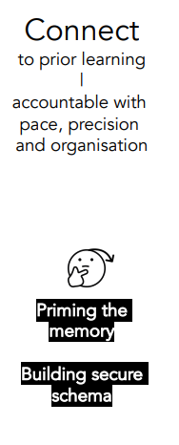
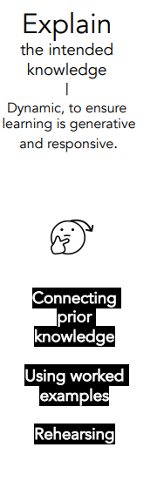
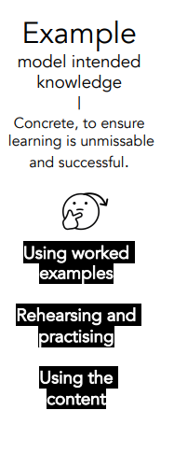
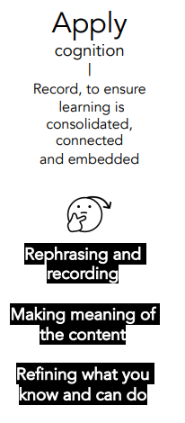
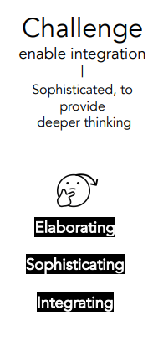
Mastery Lesson Structure at Beechcroft

Slide 2
Teaching and Learning Provision at Beechcroft
Universal quality first teaching (embedded within all classrooms) Teachers – Subject Leaders – Curriculum Lead – Learning Assistants
Structured, pre-planned and prepared sequence of lessons Schemes of work support effective curriculum sequencing CUSP learning resources and Learning Questions Clear subject planning Long term plans identify overall sequencing and rationale | Positive, high expectations and aspirations for all Specific praise and reward Behaviour policy/ classroom routines Learning behaviours No ceiling to learning | Explicit vocabulary teaching and choice of language Oral language in EYFS Vocabulary explicitly taught and revisited Knowledge organisers, vocabulary mats/strips, dual coding Displayed Orally rehearsed | Explicit modelling and demonstration Enhancements to provision Metacognitive thinking My turn Our turn Your turn Stuck strategies | Clear chunked instructions – small steps learning My turn Our turn Your turn Manipulatives | Frequent checking of understanding Retrieval practice Cumulative quizzing Mini white boards Visual check ins | Responsive teaching Talk partners LA or teacher working with specific groups Awareness of class needs | Accurate and continued assessment Observing during provision Constructive and instant feedback at the point of learning | Review, repeat, recall, retrieve Provision supports retrieval of key concepts and learning Making connections to prior learning Oral rehearsal Low stakes assessment
Targeted support for identified children/lowest 20% (Based on knowledge of children through data analysis, observation and pupil voice) Teachers - SENDCO - Subject Leaders – Learning Assistants
Scaffolding and structured practice Temporary support to enable children to access the learning Physical stem sentences Worked/partially worked examples | Cognitive load What is the core content? Tier 2 language key focus Need to know, neat to know Allows learning to be chunked into manageable sections Talking tins/technology/now and next boards | Explicit modelling and instruction Connect, explain, example, attempt, apply and challenge Safe, familiar learning routines Task boards Chunking knowledge notes/learning into manageable sections Over emphasising vocabulary – explicitly using in oral and written explanations Repetition of modelling | Alternative ways of recording Word paths, question stems, sentence stems Drawing, scribing, Clicker, whiteboards Sensory alternatives Technology to support | Additional targeted adult support Teacher and LA to support children Pre teaching Social stories Sensory/movement breaks 1:1 reading Saying name before instructions Learning tools Links with specialist teacher and SALT advice Multisensory approach,

